Slide 1
Coding for Women
Diana Adamczyk, Daisy Murray

Slide 2
What you will achieve by completing this course
An introduction to Coding with go.
You will create your own website.
You will be confident to continue learning to code

Slide 3
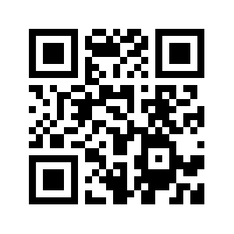
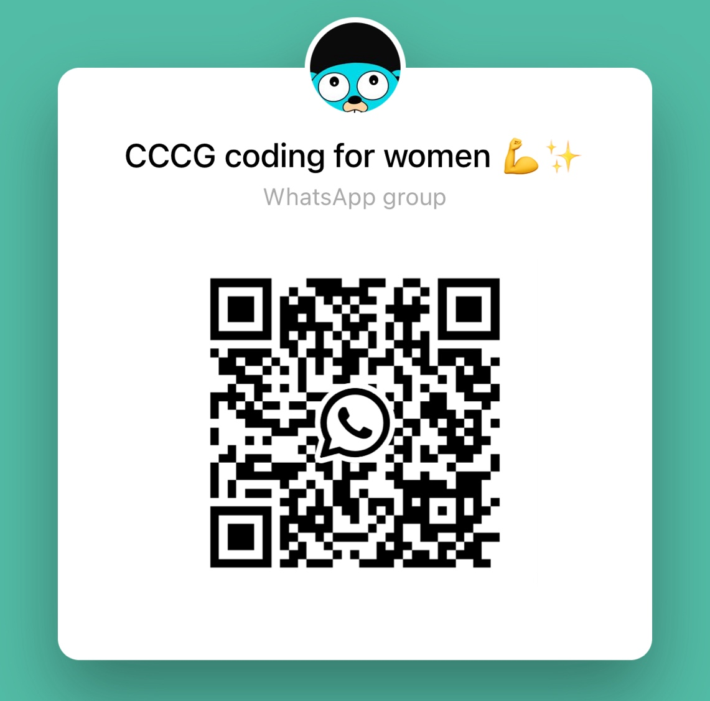

Join our discord server & WHatsapp Group
Scan to join Discord
www. discord.com

Slide 4
How this course works and expectation
8️⃣ weeks
Please attend in person if you can, you will learn more 👩🏽‍💻
We will set homework every week ✅
The more you put in, the more you will get out 🙇🏻‍♀️
Trust the process, this is a new skill, it takes take for knowledge to stick! 🧠
Please ask for help when you need it. We love it when you ask questions 💖

Slide 5
What will we learn
We will learn basic organisation of Go, data types and will create the backend of your own website.
Week 1 : introductions, set up,what is go, create your first function
Week 2: data types in variables, control flow
Week 3: Advanced functions, composite data types
Week 4: Progress check in
Week 5: Start project
Week 6: Project
Week 7:Project
Week 8: Finish Project

Slide 6
What is Go?
A free, open-source programming language created at Google by Robert Griesemer, Ken Thompson and Rob Pike.
First release was 2011.
The goals of the Go project were to eliminate the slowness and clumsiness of software development at Google, and thereby to make the process more productive and scalable.
Notes:
https://www.practical-go-lessons.com/chap-2-the-go-language Definition of some concepts
Build time : the amount of time necessary for a compiler to generate a machine-readable executable.
Statically Typed Language : Giving a precise definition of this concept is now premature. We will cover this term in the next chapters.
Dependency : a piece of software that is used by another software.
Scalability : the ability for a program to handle an increasing amount of tasks to be performed. For instance, a website is said to be scalable if it can accept an increasing number of requests without downtimes or increasing loading latency.

Slide 7
The aims of Go are to be expressive, fast, efficient, reliable and simple to write.
Simple Syntax
Compiled Language
Statically typed
Concurrency
Dependency management
Go is used for server-side (backend) programming, web development, game development, cloud-based programming, and even Data Science. It is also popular for making command-line tools.
Today, many tech giants use Go like Google, Netflix, Twitch, Ethereum, Dropbox, Kubernetes, Docker, Heroku, and lots more.

Slide 8
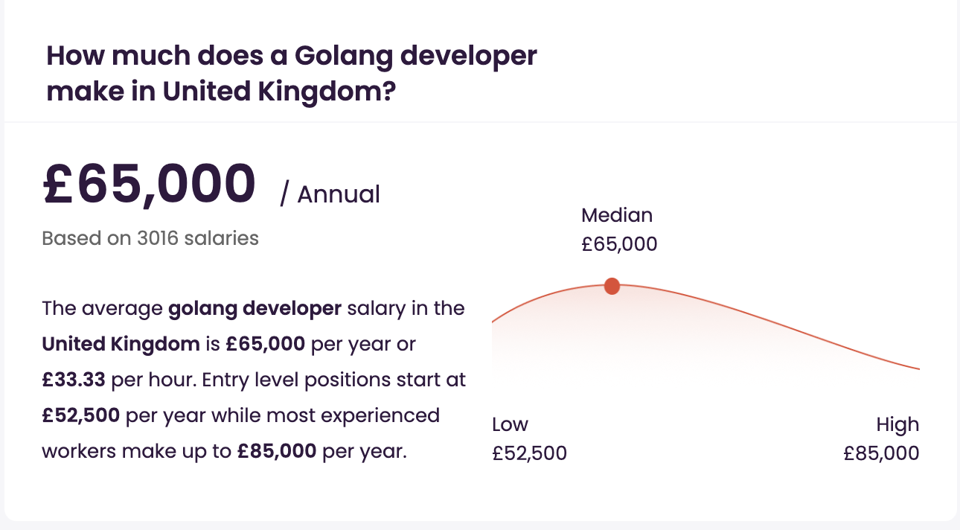
Job prospects?
https://uk.indeed.com/q-golang-developer-jobs.html?vjk=58345cabd84f0d76

Slide 9
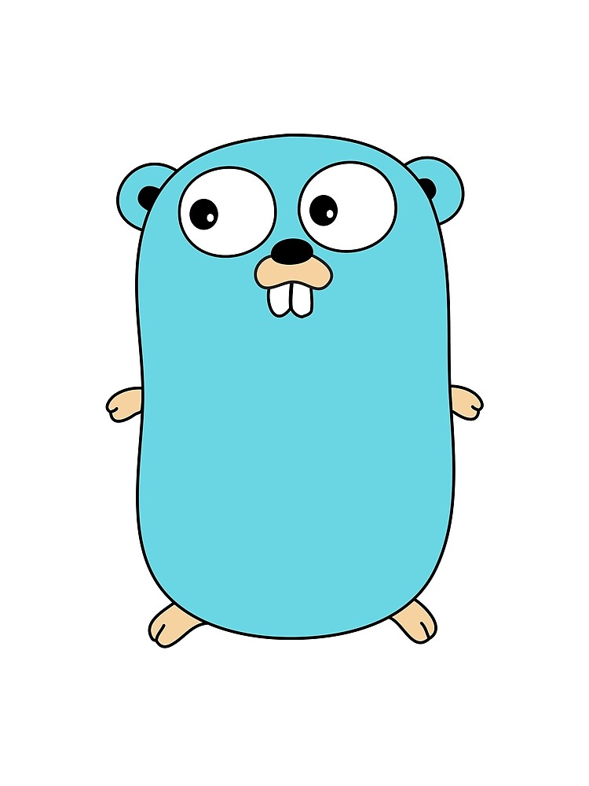


Let’s get you Set up!
If you have your laptop, download Go
Also download VS code
Create an account on GitHub to upload and save your work!
Notes:
Install Go
Install VS code Make GitHub account

Slide 10


Let’s Meet each other

Slide 11
Please fill out the google FORM
https://forms.gle/U8ssQZyA1s1PHyCB8
- please log onto your Discord Account, you will find this link
- we will share resources here

Slide 12
Week 1
Introductions
Write your first functions!
Installing Go and VS code
Questions?

Slide 13
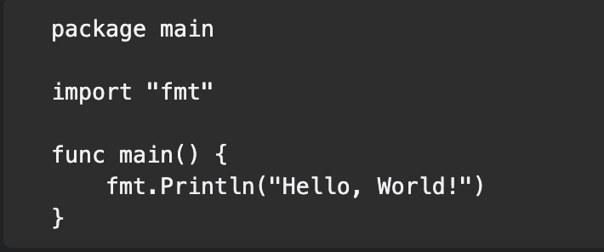

Paste the following into your file
Add picture house and door
Declares the package the code belongs to
Make the fmt (format) package available for use
Declare the main function
<package>.<function>( X x your logic x X)

Slide 14
We’ve encountered 3 keywords so far (there are 25 key words)
package : All code in Go is organised into packages. Each package corresponds to a single idea.
import : we can import premade packages, to call a collect of functions we want to use.
The math package provides functions like sqrt (square root), Sin, Cos, Tan
The fmt package provides functions to format text Println(), Printf(), append()
func : declares a function
Its followed by () {XXX code inside}

Slide 15
func : declares a function
The body of each function is enclosed in curly brackets. This is how Go knows where each function begins and ends
func main () is special…. When you run a program written in Go, execution begins at the main function in the main package. Without main the Go complier will report an error, because it doesn’t know where the program should start.

Slide 16
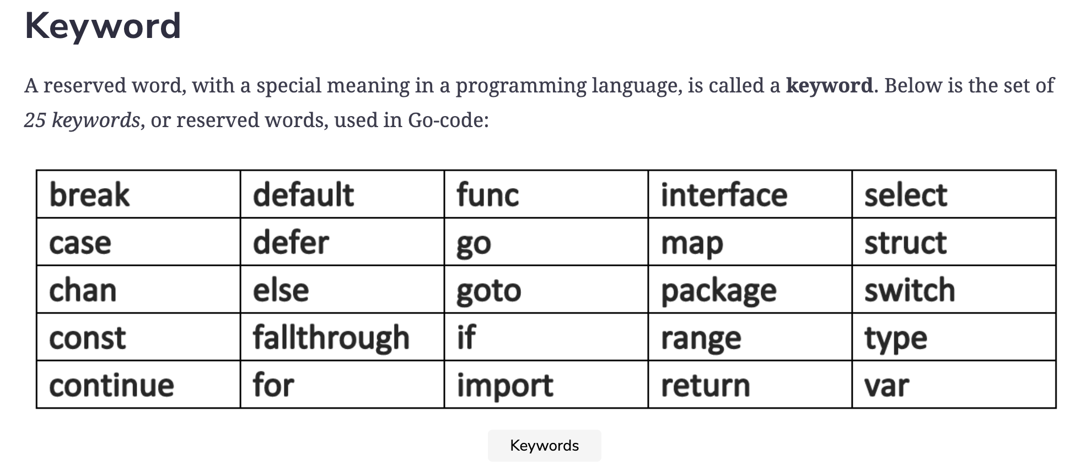

Slide 17
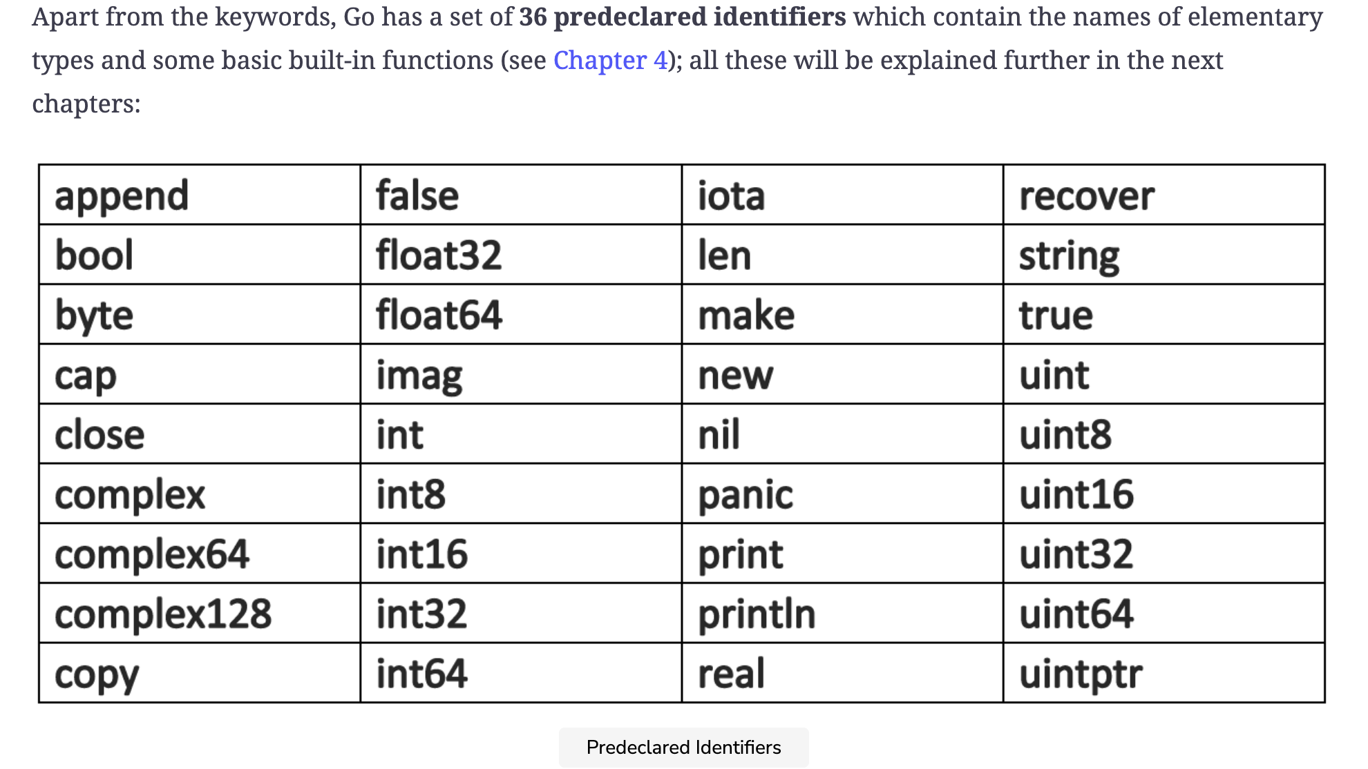

Slide 18
Comments – to make your code more readable
//this is how you add a comment
/* you can block out several lines of cooooooooooooooooooooooooooooooooooooooooooooooooooooooooooooooooooooooooooooooooooooooooooooooooooooooooooode like this */

Slide 19
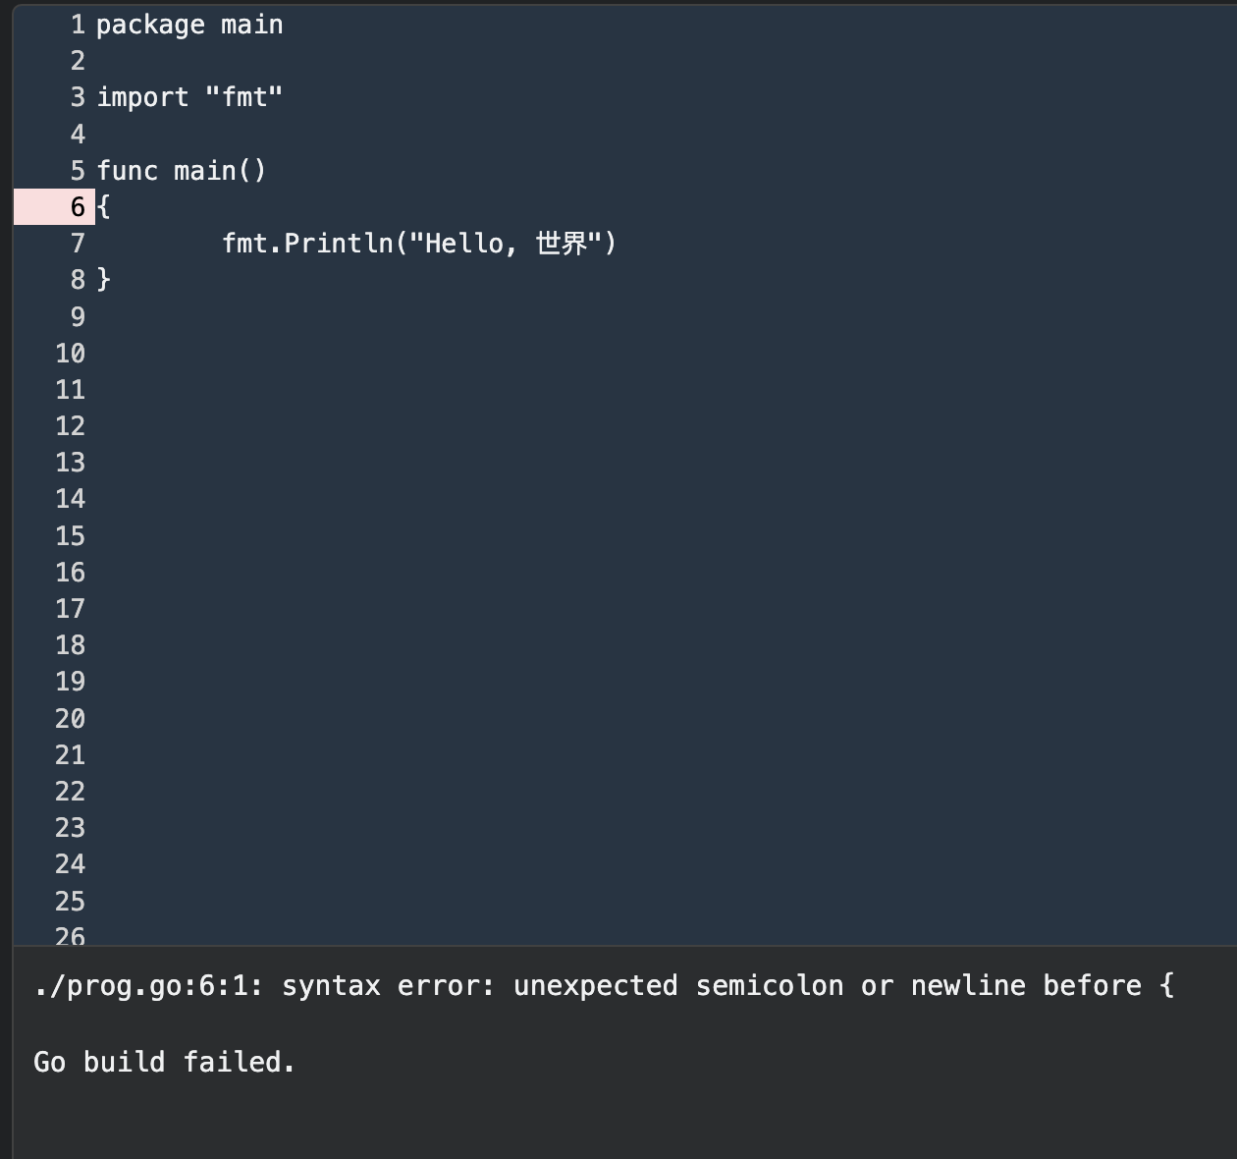
Why didn’t this run?
Opening curly brackets need to be on same line as the func declaration

Slide 20
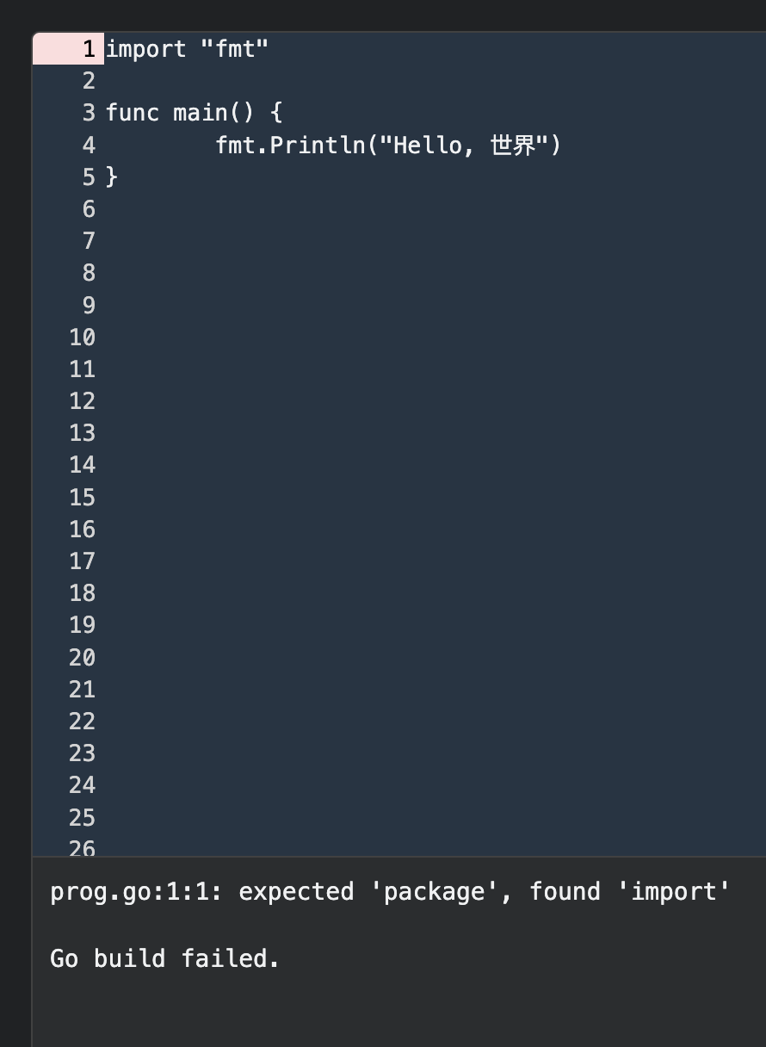
Why didn’t this run?
No package was declared, every file needs to be within a package.

Slide 21

Where does a go program start?
A program starts at the main function in the main package

Slide 22
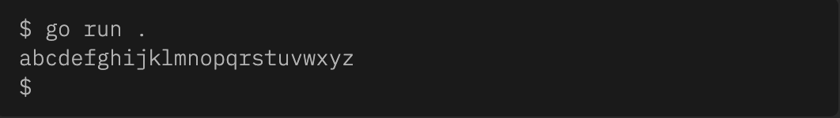
Let’s create our first program in Go!
1. create a file called “ isAlpha.go” inside, create a function “PrintAlphabet” that prints the Latin alphabet in lowercase on a single line.
A line is a sequence of characters preceding the end of line character ('\n').

Slide 23
To run your code type go run <name of program>
The ‘go run’ command executes the program. Your can type in the file name ‘main.go’ or ‘.’ which means the current directory file I am in.
! Don’t forget the file extension !n ’<filename>.go’ when calling files

Slide 24
Exercise 2
Write a file called “PrintDigits.go” inside, write a function “PrintDigits” that prints the decimal digits in ascending order (from 0 to 9) on a single line.
A line is a sequence of characters preceding the end of line character ('\n').

Slide 25
Exercise 3
Write a file called “reverseAlphabet.go”
Inside, write a function “ReverseAlphabet” that prints the Latin alphabet in lowercase on a single line.
A line is a sequence of characters preceding the end of line character ('\n').

Slide 26
Now upload your work!
git add .
git commit –m “write a message on what you’re uploading”
git push

Slide 27
Important commands from the Terminal
Use these commands to navigate from the terminal:
cd -> Allows you to change directory
cd ../ -> go back one file level
cd <filename> / you can write the path to your file
ls -> list the contents of the current directory
mkdir -> create a new directory / several directories
touch -> create an empty file (s)
echo -> prints a string of text, or value of a variable to the terminal
see more commands at https://ss64.com/bash/

Slide 28
Week 2
Coding for Women

Slide 29
Week 2
By the end of this lesson
-create more functions
- learn about variables and data types
- perform operations

Slide 30
What We did last week
- set up
-made our first function

Slide 31

ANY Questions?

Slide 32
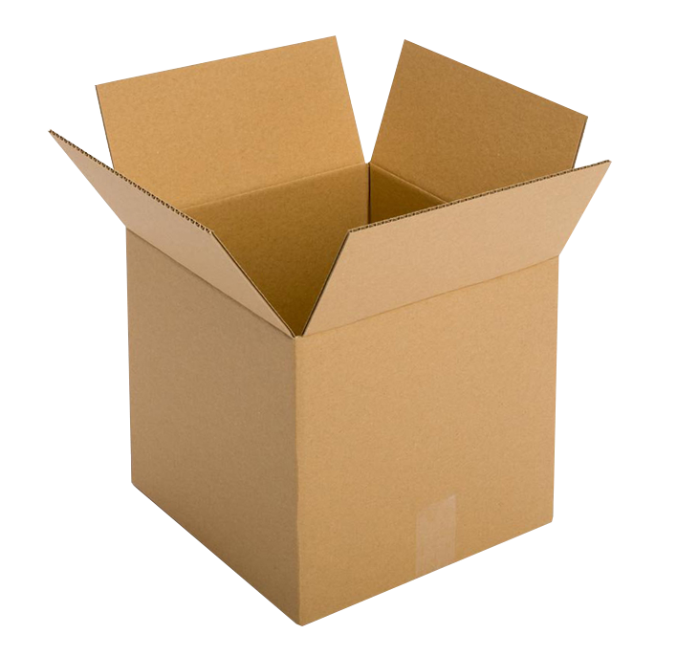
Variables
A variable is a name that represents data stored in the computer’s memory.
All variables when declared, whether explicitly or implicitly must have a type.
Basic data types:
Numbers
Strings
Booleans
think of a variable as a container that holds a value like a box that holds an object.
Notes:
To declare a variable means to create it
String “must be in double brackets”
Byte ’ a basic type that represents a single byte of binary data. In Go, bytes are commonly used for representing ASCII characters, but they can also be used to represent other binary data, such as images or audio files.’
Rune ‘Runes are used in Go to represent individual characters or characters in Unicode text.’

Slide 33
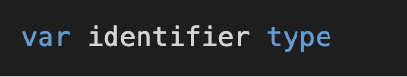
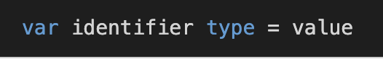
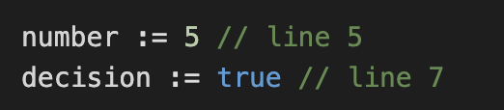
Different ways of declaring a variable
Declared using the var key word
Explicit declaration
When declaring a variable without specifiying a specific type the variable’s type is inferred by the value on the right hand side.
Implicit declaration
:= symbol for short way of declaring
Notes:
Live demonstration of variable declaration
Mention you can only implicitly declare at the function level

Slide 34
Data Type | Description | Example
string | A string of characters | var message = “Hi there”
Int | A whole number | var cars = 12
bool | A true or false value | var isEmpty = false
rune | a single character, a Unicode point | var r rune = '你'
byte | a single character, from ASCII table | var b byte = 'A'

Slide 35
When you manipulate a string in a Go program, you are effectively operating on the sequence of runes that make up the string.
A rune represents a Unicode code point, which is an integer value that corresponds to a particular character or symbol.
Runes allow for the representation of characters and symbols from many different writing systems and languages.

Slide 36
Variables that are not set to a value, are given their zero value
0 for numeric. Types
False for Boolean type
“” (empty string) for strings

Slide 37
When naming a variable
Rule | Example
CANNOT be a key word | break, continue, func , main
CANNOT contain arithmetic operators | a+b%c
CANNOT contain punctuation/special characters | &%$*£,!
CANNOT contain spaces (only underscores) | my_msg
MUST start with a letter | msg
CAN contain numbers elsewhere | msg1
CAN contain mixed case | camelCase

Slide 38
Quiz on Variables
Q1. How do you (explicitly) declare a variable? What is the key word?
var
var <nameVariable> type
var name string

Slide 39
Can you list some basic types for variables?
Bool
String
int
rune
byte

Slide 40
Q3. Which of these variables is correctly initialized?
var a = “Daisy”
var b string = “Daisy”
var c string = Daisy

Slide 41
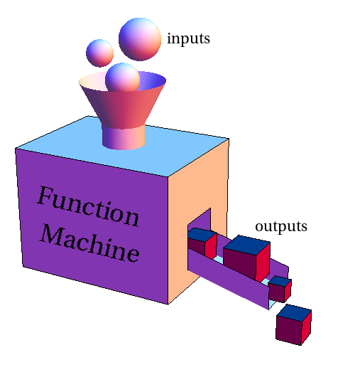
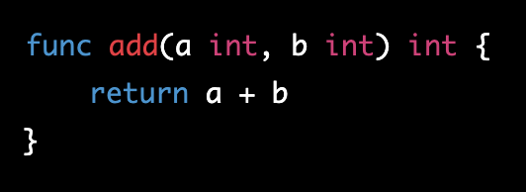
Functions
A block of code that performs a specific task or returns a value.
Functions in Go are defined using the func keyword, followed by the name of the function, a list of parameters (if any), and the return type (if any)

Slide 42
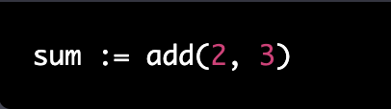
Functions in Go can be called from other parts of your program, passing in arguments and receiving the return values.
Here's an example of calling the add function we defined earlier:
This code calls the add function with the arguments 2 and 3, and assigns the result (5) to the variable sum.

Slide 43
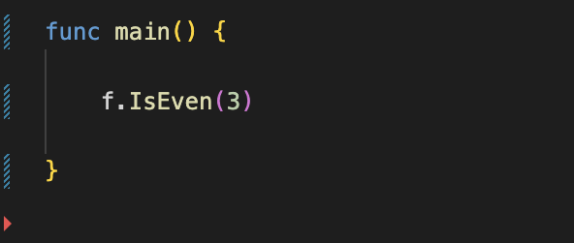
Go functions accept 0 or more parameters (inputs)
So far we have just been printing values directly onto the terminal and then the computer forgets them!
However, if you want to keep the values to use, add a ‘ return ‘ keyword to the function. You state what type of variable(s) you are returning
You can invoke a function by calling it (i.e. writing it’s name) and you can pass arguments inside the brackets
Notes:
Mention parameter vs argument
Daisy to demonstrate calling a function
// add picture of return function

Slide 44

Things to keep in mind!
when variables are declared, they either explicitly or implicitly are assigned a type even before your program runs.
Go requires that every variable you declare gets used somewhere in your program
You can assign new values to existing variables, but they need to be values of the same type.
A variable declared within a function only exists that function
Notes:
//show example of for loop?
// an example where a variable only exists in that function – live demo to break up slides

Slide 45
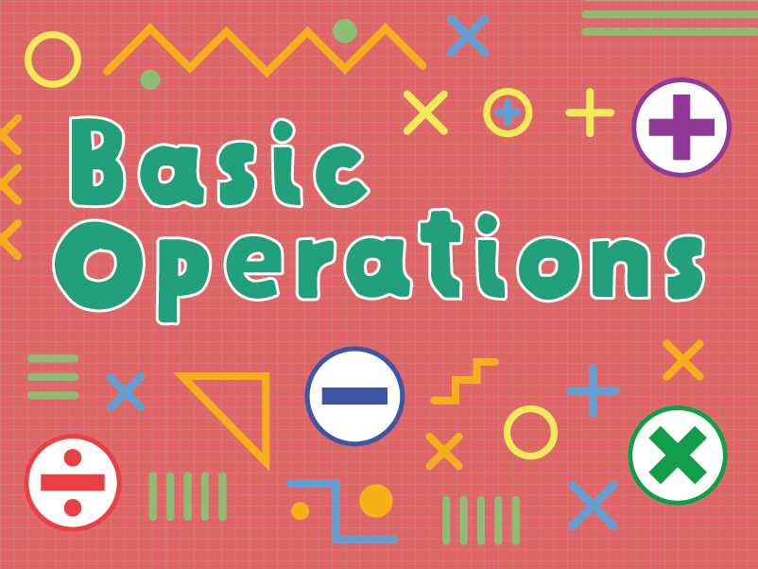

Slide 46
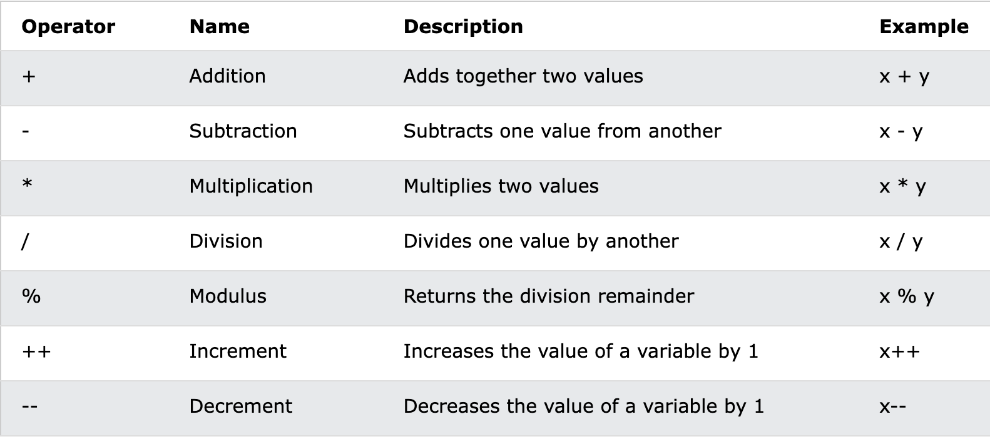
Arithmetic operators

Slide 47
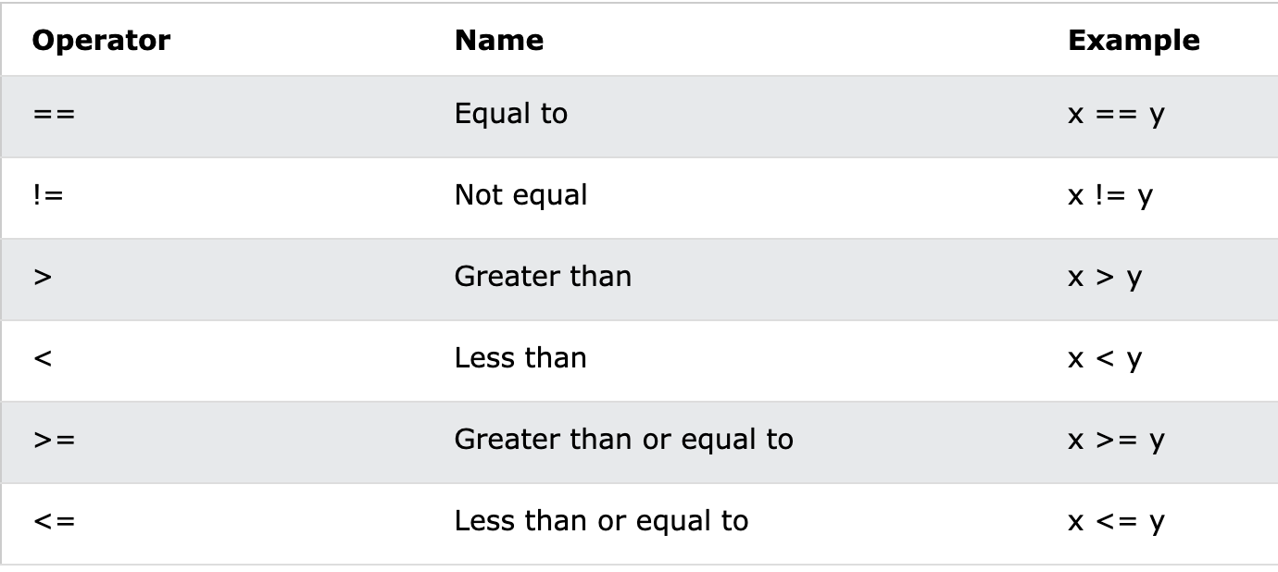
Comparison operators

Slide 48
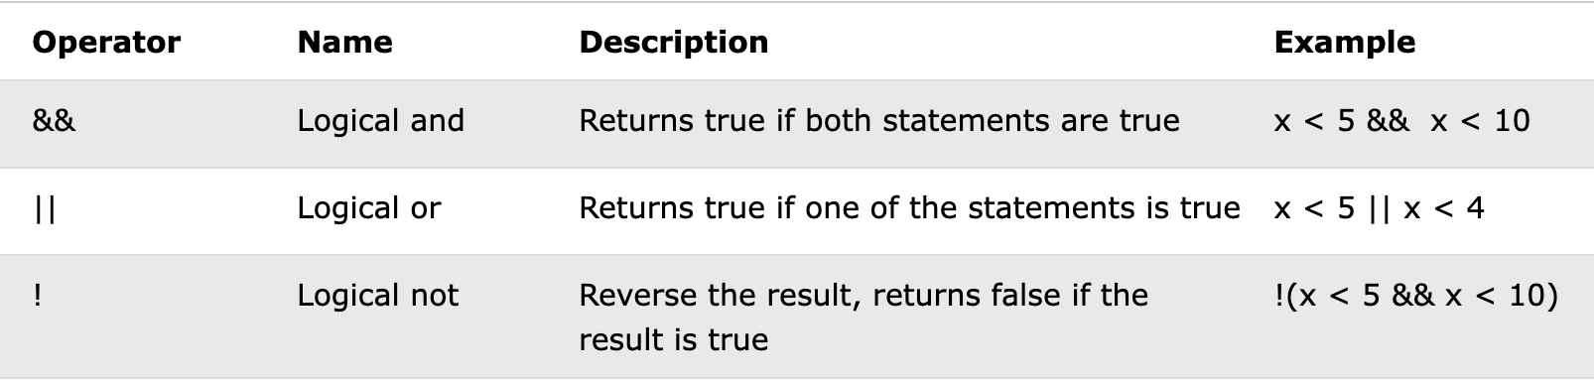
Logical operators

Slide 49
Exercise
Create a function called IsEven
When you input a number to the function, it will print to the terminal “Even” if the number is even, “Odd” if the number is odd.

Slide 50
Scope of Variables
Global scope: the variables with such scope are visible and available in all files of a package.
Local scope: the variables are only known within that function;
Global scope
Local scope
Local scope
Local scope

Slide 51
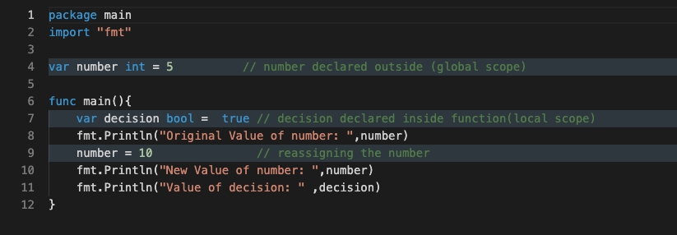

Slide 52
Constant
A constant is a name for a fixed value.
The value of a variable can vary, but the value of a constant must remain constant.
Constants are declared with the const key word
Constants can’t be declared with := syntax
Constants can be of any data type, just like a variable

Slide 53
Quiz
Q1. A file containing Go code has to have what extension?
.go

Slide 54
Q2. Are these variables the same?
var Name = “Diana”
var name string = “Diana”
Var NAME = “Diana”
No variable names are case sensitive

Slide 55
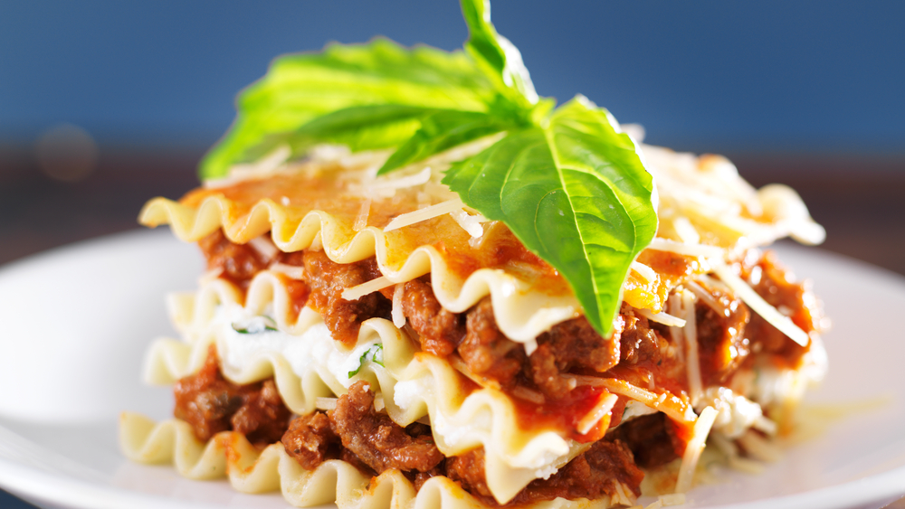
Lasagna Challenge
https://exercism.org/tracks/go/exercises/lasagna/edit
Notes:
Daisy to run this

Slide 56
Challenge
Implement a function which will convert Celsius to Fahrenheit. Types of temperatures are float32 which are aliased to Celsius and Fahrenheit for you.
func toFahrenheit(t Celsius){
}
Temperature in ˚F = (Temp in °C * 9/5) + 32

Slide 57
Type conversion
You can convert some data types, but not all types can be converted to each other.
int to a float: just write it as a whole number.
float32 / float64 to int: You can convert a floating-point number to an int by using the int() function
int to string: You can convert an int to a string using the strconv.Itoa()
string to int: You can convert a string to an int using the strconv.Atoi()
byte to string: You can convert a byte (or a slice of bytes) to a string using the string() function.
string to byte: You can convert a string to a byte (or a slice of bytes) using the []byte() function.

Slide 58
WEEK 3
Coding for women

Slide 59
What we’re learning this week
Arrays
Slices

Slide 60
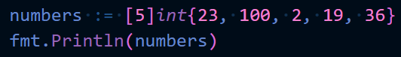
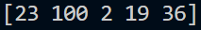
Arrays
Arrays hold a set number of a group of items of the same type.
For example you might want to hold a list of numbers
When creating an array you separate an the values using commas, when printing it is shown with elements separated by spaces.

Slide 61
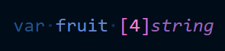
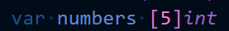
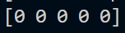
Arrays
Here we are telling the computer the type of the variable ‘fruit’ is an array of length four and the element type is string.
Creating an array variable without assigning a value will create an array of the specified length with the zero value of the given element type
[ ] = this is an array
4 = the array will be of length four
string = the elements of the array will be strings
{ } = the contents inside the curly brackets is the contents to put in the array

Slide 62
Arrays
Using the … syntax allows the array to automatically determine the number of elements.
So this
Is the same as this

Slide 63
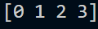
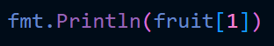
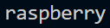
Accessing Array Values
Elements in an array can be accessed by using the index of the value you want.
The index is a numerical value that starts at 0.
Index points of fruit =

Slide 64
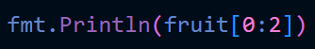
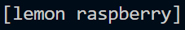
Accessing Array Values
Multiple elements can be accessed by using creating a slice using : to tell the code you want to look at multiple ___ index points.
The rule for this syntax is arrayName[startIndex:endIndex] where the starting index is included but the ending index is excluded.
Lemon is at index 0 (this is included in the array slice)
Raspberry is at index 1 (this is included in the array slice)
Passion fruit is at index 2 (this is NOT included in the array slice)

Slide 65
Accessing Array Values
Lemon is at index 0 (this is included in the array slice)
Raspberry is at index 1 (this is included in the array slice)
Passion fruit is at index 2 (this is NOT included in the array slice)
lemon
raspberry
passion fruit
cherry
0
1
2
3

Slide 66
Slices
Slices can be made as a subsection of an existing array or they can be declared in the same way as arrays except no element count is given.
When made directly Go will create an array underlying array of the appropriate length and capacity, which will change along with the slice.
Unlike arrays which have a static length slices can have variable lengths. This makes them more flexible and powerful as the slice can grow or shrink to suit your current needs.

Slide 67
Slices
There are three important functions to know when using slices
len retrieves the current number of elements in a slice (the length of a slice)
cap retrieves the number of elements the slice can hold before it must be resized (the capacity of a slice)
append adds an element to the end of a slice
The len and cap functions can also be used on arrays however append is only for slices as arrays cannot change their length

Slide 68
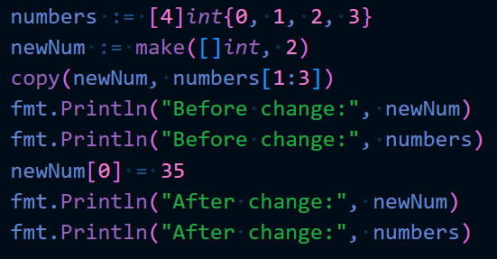
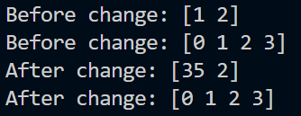
It is important to know that is you wish to copy a slice or array you must use the built-in copy function
Result of code:
The copy function takes the destination slice as the first argument and the source slice as the second, and both slices must be of the same type.
The one major thing to note: the lengths of both destination and source slices do not have to be equal. It will only copy up to the smaller number of elements. So if you attempt to copy to an empty or nil slice, nothing will be copied.

Slide 69
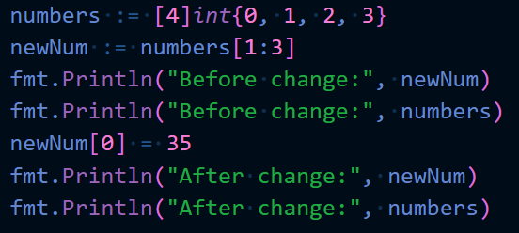
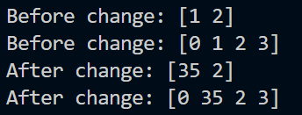
If you don’t use the copy function then both the original slice and the duplicate/sub slice will both be changed
Result of code:
As you can see after changing an element in newNum, the corresponding element in numbers also changed.

Slide 70
Maps
A map is an unordered collection of key-value pairs, where each key is unique.

Slide 71
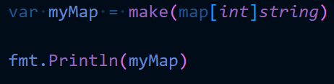
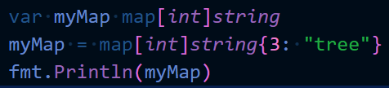
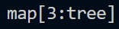
Maps
To create a empty map you can use the make function, this initialises the map so it is an empty map not a nil map.
The difference between a nil map and an empty map is how data can then be added to them.
For a nil map data can only be added by setting the variable to a map of the same type as specified. This will initialise it.

Slide 72
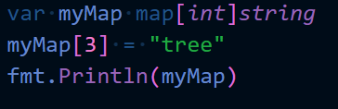
Maps
To create a empty map you can use the make function, this initialises the map so it is an empty map not a nil map.
The difference between a nil map and an empty map is how data can then be added to them.
For a nil map attempting to add data directly to the map will result in an error

Slide 73
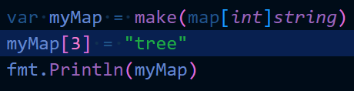
Maps
To create a empty map you can use the make function, this initialises the map so it is an empty map not a nil map.
The difference between a nil map and an empty map is how data can then be added to them.
For an empty map a new map can be assigned to them or you can add a new value pair directly without an error message.

Slide 74
Maps
Instead of numerical index points the values are accessed by their keys.
What do you think is the output of the following code:
ANSWER: 3

Slide 75
Maps
Any value can be accessed by specifying the associated key. A second value can be returned to check if the key is in the map.

Slide 76
Week 4

Slide 77
What we did last week
Arrays
Slices
Started If – Else statements

Slide 78
This week
If – Else statements continued
For loops
Package structure of Go

Slide 79

Flow control

Slide 80
Using Boolean logic
The order in which instructions are carried out
There is more than one way your program can run depending on the data you feed it. The computer will run a certain path depending on the data and the conditions you have set it.
True -> outcome1
False -> outcome2

Slide 81
If statement
You ask yourself an IF statement!!
How do you decide if to eat or not?
How do you decide if to visit the doctor or not?
How do you know if to go to bed or not?

Slide 82
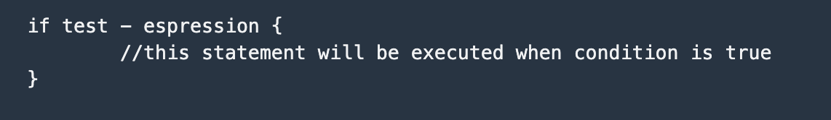
If statements

Slide 83
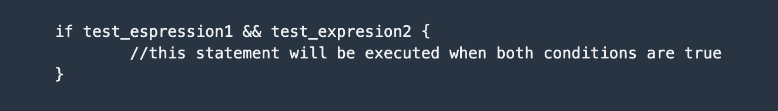
AND
2 paths, but we have not set an action for the 2nd path

Slide 84
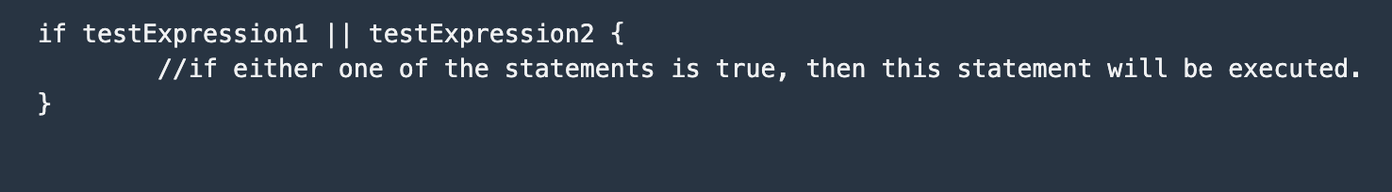
OR

Slide 85
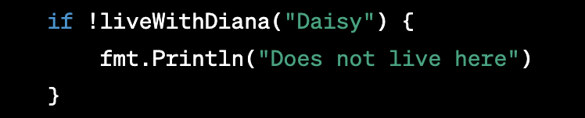
NOT ! will negate the expression.

Slide 86
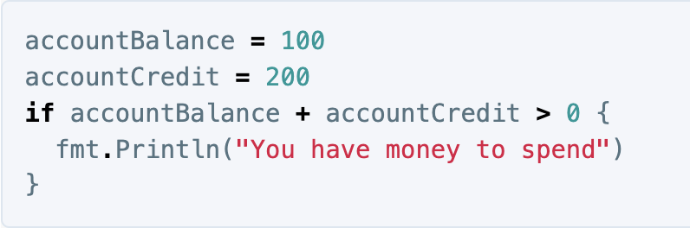
You can also use arithmetic operators.

Slide 87
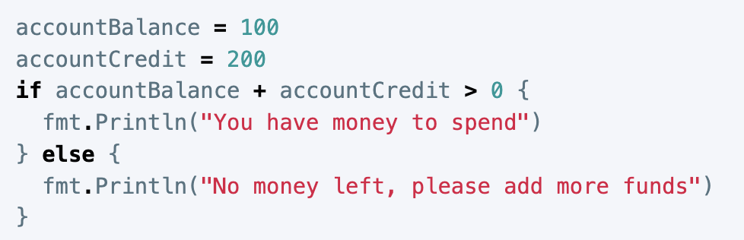
ELse
The else clause is run when if is evaluated to false.
2 paths, 2 possible actions

Slide 88
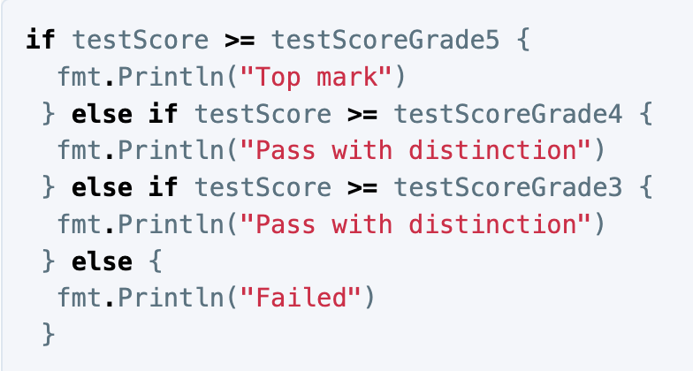
Else if
When you want to check several statements/conditions. That’s when we use if – else.
It will always check the if statements in order prioritise your statements
Notes:
We use

Slide 89

For Loops
A for loop is a type of loop that allows you to execute a block of code repeatedly for a certain number of times or until a certain condition is met.
In Go, a for loop is typically used when you need to iterate over a collection of items, such as an array or slice, or when you need to repeat a block of code a certain number of times.

Slide 90

The basic for loop has three parts separated by semicolons:
the init statement: executed before the first iteration
the condition expression: evaluated before every iteration
the post statement: executed at the end of every iteration
The init statement will often be a short variable declaration
the variables declared there are visible only within the loop
The loop will stop iterating once the boolean condition evaluates to false.

Slide 91

For range loop
index is the index of the value we are accessing.
value is the actual value we have on each iteration.
mydatastructure holds the data structure whose values will be accessed in the loop.
Used when you are more interested in value rather than location

Slide 92


The for-range loop can be used to access individual characters in a string.
terminal output

Slide 93

The for-range loop can be used to access individual key-value pairs in a map also

Slide 94
Exercise
Write a Go program that checks if a person lives in a house hold. If the person lives in the household, the program should print a message saying that person lives there.
If the person is named "Daisy" but does not live in the household, the program should print a message saying that "Daisy doesn't live there, but can come in.
If person is not named "Daisy" and does not live in the household, the program should print a message saying "stranger danger!".

Slide 95
declare an array called household and put inside the persons you live with (you can make it up!)
2. create a function called livesWithMe it takes in a string and returns a bool
Inside the function, create a for range loop to iterate over the elements of the array if the person’s name is the same as an element in your array, return true. Otherwise, return false.
3. inside func main set Person = Daisy
Create if else statements to print different messages on whether the person lives there, is Daisy, or is neither.

Slide 96

Navigating your file system
learning Bash scripting and navigating the command line is an important skill for coders, regardless of your specific programming language.
It can help you work more faster and gain greater control over your coding environment.

Slide 97


Slide 98


Slide 99


Slide 100


Slide 101


Slide 102


File structure of Go

Slide 103

Go programs are organized into packages.
A package is a collection of files in the same directory that are compiled together.
Functions, types, variables, and constants defined in one source file are visible to all other source files within the same package.

Slide 104

A module is a collection of related Go packages that are released together.
You only need 1 module per project.
The module keeps your project contained and therefore exportable – it will keep tabs on all the the packages, subdirectories, files, functions in your project.
Each module has a unique module path, which is specified in the go.mod file at the root of the module. The go.mod file also specifies the version of the Go language that the module is compatible with, as well as any dependencies(external packages/libraries you imported) that the module requires.

Slide 105
Week 5

Slide 106
What did we do last week?
Flow control : if-else statements
For loops
File structure of Go
Working in VS code

Slide 107

How does the web work?

Slide 108
What we will do
Setup a project directory which follows the Go conventions.
Start a web server and listen for incoming HTTP requests.
Route requests to different handlers based on the request path.
Manage errors
load HTML pages and use templates
Serve static files like images and CSS

Slide 109
Step 1.
Lets create a fresh repository
Notes:
1. Show website

Slide 110

First steps
Set up your main file
Create your module
Make sure that you’re in the root of the directory and then run the go mod init <nameModule> command.
Create a handler folder - package handler

Slide 111


What are handlers?
Think of handlers as being a bit like controllers. They’re responsible for executing your application logic and for writing HTTP response headers and bodies.
A handler is a function that processes incoming HTTP requests and generates the corresponding HTTP response.

Slide 112
It takes two arguments: a http.ResponseWriter object, which represents the HTTP response that will be sent back to the client, and an *http.Request object, which represents the HTTP request that the client made.
The handler function reads the request data from the http.Request object, processes it as needed, and generates the appropriate response using the http.ResponseWriter object. The response can include headers, the body, cookies, and other data that is sent back to the client.

Slide 113

Each time the server receives a new HTTP request it will pass the request on to the server which will check the URL path (“/”) and dispatch the request to the matching handler (func HomePage).

Slide 114
What is HTTP?
HTTP (Hypertext Transfer Protocol) is a protocol used to transfer data over the web. It is the foundation of the World Wide Web, and it is used by web browsers and servers to communicate with each other.
When you enter a URL in a web browser, the browser sends an HTTP request to the web server hosting the requested resource (such as a web page or image).
The server then responds with an HTTP response, which includes the requested resource (or an error message if the resource cannot be found).

Slide 115

To use this handler function in a web application, you need to use the http.HandleFunc() function.
Next up, the server

Slide 116
http.ListenAndServe() is a function that starts a HTTP server and listens for incoming requests on a specified network address.
When a client makes a request to the server, the default server that Go uses (DefaultServeMux) will look for a handler function to process the request and generate a response.

Slide 117
Step 2 - data
We are going to create a struct to hold the data we want to post to our website.

Slide 118
What is a struct?
structs are a collections of fields. It is a container where you can group several types of data
For example if you create a struct for someone who has a bank account, inside you would have fields of data relating to
- name string
-bank account number int
-account balance int

Slide 119

DECLARING AND INITIALIZING A STRUCT
A struct in Go can contain one or more fields.
Each field in the struct must have a data type. You can use the type + struct keyword to create a struct using syntax like this:

Slide 120

How to access a struct
Access struct fields with a dot

Slide 121

Step 3 – adding tags to struct
JSON (Javascript Object Notation)
In web development, JSON is commonly used as a format for transmitting data between a web server and a client application. It’s easily compressed, quick to transmit lots of data and easy for humans to read and write.
For example, when a client makes a request to a web server, the server might respond with JSON-encoded data that the client can then parse and display in a web browser or mobile app.

Slide 122
JSON tags specify the names of the JSON fields that correspond to each struct field.
For example, the Go Id field has a JSON tag of "Id", it will look for the JSON field with the name "Id".
Similarly, the Go RecipeName field has a JSON tag of "Recipe Name” which means that Go will look for the JSON field with the name "Recipe Name".

Slide 123
Week 6

Slide 124
When creating our program, one of the first steps is to create a module. What is the command to create a module, and what is a module?
go mod init <name>
- lists all the external dependencies we need for the program
- which version of Go was used to make it
- route to the module therefore the program.

Slide 125
What kind of data type is a struct?
A struct is composite data type (can hold several bits of information)
You create the fields inside your struct
We are going to create a structs to hold the data we want to post to our website.

Slide 126

How our website works
When a client (such as a web browser) wants to access a web page or web application, it sends an HTTP request to the server that hosts the web page or application. The server receives the request, and then passes the request to the appropriate handler function, which generates a response that is sent back to the client. The client then receives the response and renders it in the browser window.

Slide 127
The client-server relationship is typically based on the HTTP protocol, which is the standard protocol used for communication between web browsers and servers.
It’s a common language, set of mutually understandable instructions

Slide 128

What is a server
A server is a computer program (dedicating to serving files, its not used as a workstation) that listens for incoming network requests and responds to those requests by providing data or services.
The client, your computer will make a request to the server for a connection and for data.

Slide 129
Handlers
Handler functions are functions that are called by servers to process incoming requests and generate responses.

Slide 130

Step 4 create a global variable of []struct recipe
We have created a container to store our recipe.
We now want to duplicate this format to store ALL of our recipes that’s why we create a slice of recipe.

Slide 131

Step 5 create function to ‘fetch’ data

Slide 132
http.Get
The HTTP GET method is used to read (or retrieve) a representation of a resource.
In case of success, GET returns a representation in JSON
The go package http has a function Get that sends a GET request to the specified url you want to get the information from.
http.Get(“url”)

Slide 133
HTTP Methods
POST – Creates
GET – Reads
PUT – Updates
DELETE – Deletes
GET and POST are the only methods we will be using for our website.
(part of protocol)

Slide 134

.57 seconds

Slide 135
io.ReadAll
io package has a function ReadAll which will take a file/some data and convert it into a []byte. The []byte can then be edited or more easily converted into other data types, depending on the desired outcome.
[]byte are also the required input type for a lot of functions that allow you to write data to a specified location. Such as the next function we will use.

Slide 136
json.Unmarshall()
This function takes two inputs:
A []byte which represents the data to be ‘unmarshalled’
The location where you want the data to go.
Unmarshalling is the conversion of JSON to Go objects. In our case from JSON to structs. The json tags on the struct help tell the unmarshall function where each bit of data should go.

Slide 137
___.Close
Whenever opening/reading a file it should be closed. This is to prevent the file from taking up memory space unnecessarily which will cause a memory leak.
A memory leak is a failure in a program to release discarded memory, causing impaired performance or failure.

Slide 138
defer
Using the keyword defer tells the program you want the following action to happen at the end of the code block.
Using defer ensures the code is carried out whenever the code terminates regardless of any flow control later on.
This means that if you have a function with an if/else statement and you want a specific action to occur at the end of the code regardless of where in the if/else the code terminates defer will allow this to happen

Slide 139
step 6 test if we managed to fetch the data
Run our function to see what comes up on the terminal!
We should a loooong slice contain all our recipes

Slide 140
Week 6

Slide 141
When creating our program, one of the first steps is to create a module. What is the command to create a module, and what is a module?
go mod init <name>
- lists all the external dependencies we need for the program
- which version of Go was used to make it
- route to the module therefore the program.

Slide 142
What kind of data type is a struct?
A struct is composite data type (can hold several bits of information)
You create the fields inside your struct
We are going to create a structs to hold the data we want to post to our website.

Slide 143
How our website works
When a client (such as a web browser) wants to access a web page or web application, it sends an HTTP request to the server that hosts the web page or application. The server receives the request, and then passes the request to the appropriate handler function, which generates a response that is sent back to the client. The client then receives the response and renders it in the browser window.

Slide 144
The client-server relationship is typically based on the HTTP protocol, which is the standard protocol used for communication between web browsers and servers.
It’s a common language, set of mutually understandable instructions

Slide 145
What is a server
A server is a computer program (dedicating to serving files, its not used as a workstation) that listens for incoming network requests and responds to those requests by providing data or services.
The client, your computer will make a request to the server for a connection and for data.

Slide 146
Handlers
Handler functions are functions that are called by servers to process incoming requests and generate responses.

Slide 147
Step 4 create a global variable of []struct recipe
We have created a container to store our recipe.
We now want to duplicate this format to store ALL of our recipes that’s why we create a slice of recipe.

Slide 148
Step 5 create function to ‘fetch’ data

Slide 149
http.Get
The HTTP GET method is used to read (or retrieve) a representation of a resource.
In case of success, GET returns a representation in JSON
The go package http has a function Get that sends a GET request to the specified url you want to get the information from.
http.Get(“url”)

Slide 150
HTTP Methods
POST – Creates
GET – Reads
PUT – Updates
DELETE – Deletes
GET and POST are the only methods we will be using for our website.
(part of protocol)

Slide 151
.57 seconds

Slide 152
io.ReadAll
io package has a function ReadAll which will take a file/some data and convert it into a []byte. The []byte can then be edited or more easily converted into other data types, depending on the desired outcome.
[]byte are also the required input type for a lot of functions that allow you to write data to a specified location. Such as the next function we will use.

Slide 153
json.Unmarshall()
This function takes two inputs:
A []byte which represents the data to be ‘unmarshalled’
The location where you want the data to go.
Unmarshalling is the conversion of JSON to Go objects. In our case from JSON to structs. The json tags on the struct help tell the unmarshall function where each bit of data should go.

Slide 154
___.Close
Whenever opening/reading a file it should be closed. This is to prevent the file from taking up memory space unnecessarily which will cause a memory leak.
A memory leak is a failure in a program to release discarded memory, causing impaired performance or failure.

Slide 155
defer
Using the keyword defer tells the program you want the following action to happen at the end of the code block.
Using defer ensures the code is carried out whenever the code terminates regardless of any flow control later on.
This means that if you have a function with an if/else statement and you want a specific action to occur at the end of the code regardless of where in the if/else the code terminates defer will allow this to happen

Slide 156
step 6 test if we managed to fetch the data
Run our function to see what comes up on the terminal!
We should a loooong slice contain all our recipes

Slide 157
Week 7
Templates in Go, HTML, CSS

Slide 158
What we did last week
We created a container ([]recipe struct variable) to store all our recipe data from JSON
We created a function to fetch the data from the JSON and be able to use in our HTML

Slide 159
Quiz

Slide 160

What is a server?
A server is a computer which listens for http request and serves a response

Slide 161

What is a struct?
A data type which can hold multiple fields of data. You can create your own specific variable type.

Slide 162
How would I access the Name field of this Person stRuct?

Slide 163
Why did we create a package data? Why not keep everything in package main?
Separation of concern
It is good practice to make different packages for parts of your code that have different purposes.
Make the code reusable
Makes the code scalable
If something breaks in one package, the other packages will still work

Slide 164

Why did we put defer.info.close() after getting the json data?

Slide 165

What is this code doing?
1. We are setting up a server: with the net/http package http.ListenAndServe(“:PortNumber”)
1.
2.
2. Create a handler function helloWorld it will handle any requests made to “/” and the ‘w’ http.ResponseWriter will serve the the response “Hello World”
2.
1.

Slide 166


Templates!
We use templates to integrate HTML with Go (as they are 2 different languages)
HTML( HyperText Markup Language) is mark-up language to do with how your web page and its content looks.
Go is used for the backend functionality.
Templates allow us to load variables and perform some functions on the HTML script.
Notes:
Explain what are templates

Slide 167

HTML Boilerplate
boilerplate code or just boilerplate are sections of code that are repeated in multiple places with little to no variation.
A boilerplate in HTML is a template you will add at the start of your project. You should add this boilerplate to all of your HTML pages.

Slide 168

What is a doctype in HTML?
The doctype tells the browser what version of HTML the page is written in.

Slide 169

What is the HTML root element?
The <html> tag is the top level element of the HTML file
The head tag and body tag are both nested inside the html tag. (in other words everything is inside the html.)
The ‘lang’ attribute sets the language for the page. It is good to include it for accessibility reasons, so screen readers know how to pronounce the text.

Slide 170

What are head tags?
<head> tags contain metadata
Metadata is information to be processed by machines
It describes the data being given to the machine

Slide 171
The charset metadata attribute tells the machine what character set the page uses.
UTF-8 is the standard character encoding.
It supports many languages and can support pages and forms in any mixture of those languages.

Slide 172
The viewport meta tag tells the machine how wide to render the page and the initial level of zoom.
E.g. if your device was 600px wide, the machine would know to render the web browser to be 600px wide.

Slide 173
The X-UA-Compatible meta tag specifies the document mode for Internet Explorer.

Slide 174
The <title> tag is the name of the tab

Slide 175
The <link> tag connects the html to a css file
(the part of the head we care about)

Slide 176

What are body tags?
The body tags contain all the visible content.

Slide 177
In Go, we have the template package to help handle templates.
We can use functions like Parse, ParseFile and Execute to load templates from files.

Slide 178
Inserting data into a template
In Go, Every field that you intend to be rendered within a template should be put inside of {{}}
The dot inside {{.}} is shorthand for the current object.
If you want to access specific fields of the current object, you should use {{.FieldName}}

Slide 179
Ranging over composite data
You can do a for loop and range over arrays/maps
{{range …}}{{end}}
Notes:
Start code presentation

Slide 180
We are going to upgrade our server
We use NewServeMux to handle our routing
Our website handles many requests (end points), having just 1 handler for “/” GET is not enough! Our website has more functionality!
We will also use it to read our CSS files
NewServeMux!
Notes:
After this make sure students have HTML and CSS files.

Slide 181

Now let’s add css!
To make our page look prettier – we can add CSS
We have to link our HTML document to the CSS which will reads the HTML tags.
We have to link the HTML and the Go.
Notes:
Give brief description of what CSS is.

Slide 182


CSS stands for Cascading Style Sheets
CSS describes how HTML elements are to be displayed on screen, paper, or in other media
CSS saves a lot of work. It can control the layout of multiple web pages all at once

Slide 183
How we access the static (CSS) files
Fileserver finds the location of CSS file
Once inside the file, we send it to the server

Slide 184
What the HTML tags mean?
We’re using a form to submit information (click on a button to get a recipe back)
<form method=“POST” action=“what will happen” class =“for CSS” />
When <button/> clicked
Button will submit form
We split the text using: <header> <h3> (size of header text) <p> - paragraph <footer>
Notes:
Explain the tags

Slide 185
Week 8
Finishing the project and final review

Slide 186
What we did last week
We learnt what some of the HTML tags means
We used Templates to add our Go variables into our HTML
We learnt what {{.}} and {{range .VarName}} {{end}} means
We updated our server to handle several requests

Slide 187
What we will do this week
Create handler function for recipe pages
1
Routing logic for the different recipe end points
Create the HTML for the recipe page
2
Update homepage HTML to make buttons
3

Slide 188

Let’s open up VS code and finish this!
Notes:
Please try to finish in 1h so we have time to do the final review.

Slide 189
RecipeName: “Chocolate Chip Cookies”
PrepTime: “20 mins”
CookTime: “12-15mins”
ServingSize: 15
Tags: [“Chocolate”, “Cookie”]
RecipeName: “Hot Dog Pretzels”
PrepTime: “30 mins (+ 1.5-2.5 hours proving time)”
CookTime: “15 mins"”
ServingSize: 8
Tags: [“Meat”, “Bread”]
Recipe1
Recipe2
Range over current object ([{recipe1},{recipe2},etc.])
{{range .}}
{{.}}
{{end}}
New current object = Individual Recipe
Output =
{recipe1}
Tells the computer where to end the loop – only the code between range and end will be repeated

Slide 190
RecipeName: “Chocolate Chip Cookies”
PrepTime: “20 mins”
CookTime: “12-15mins”
ServingSize: 15
Tags: [“Chocolate”, “Cookie”]
RecipeName: “Hot Dog Pretzels”
PrepTime: “30 mins (+ 1.5-2.5 hours proving time)”
CookTime: “15 mins"”
ServingSize: 8
Tags: [“Meat”, “Bread”]
Recipe1
Recipe2
Range over current object ([{recipe1},{recipe2},etc.])
{{range .}}
{{.}}
{{end}}
New current object = Individual Recipe
Output =
{recipe2}
Tells the computer where to end the loop – only the code between range and end will be repeated

Slide 191
RecipeName: “Chocolate Chip Cookies”
PrepTime: “20 mins”
CookTime: “12-15mins”
ServingSize: 15
Tags: [“Chocolate”, “Cookie”]
RecipeName: “Hot Dog Pretzels”
PrepTime: “30 mins (+ 1.5-2.5 hours proving time)”
CookTime: “15 mins"”
ServingSize: 8
Tags: [“Meat”, “Bread”]
Recipe1
Recipe2
Range over current object ([{recipe1},{recipe2},etc.])
{{range .}}
{{.}}
{{end}}
New current object = Individual Recipe
Output =
{etc.}
Tells the computer where to end the loop – only the code between range and end will be repeated

Slide 192
What will the output be in the following code?

Slide 193
RecipeName: “Chocolate Chip Cookies”
PrepTime: “20 mins”
CookTime: “12-15mins”
ServingSize: 15
Tags: [“Chocolate”, “Cookie”]
RecipeName: “Hot Dog Pretzels”
PrepTime: “30 mins (+ 1.5-2.5 hours proving time)”
CookTime: “15 mins"”
ServingSize: 8
Tags: [“Meat”, “Bread”]
Recipe1
Recipe2
{{range .}}
{{.RecipeName}}
{{end}}
Recipe1
Recipe2
OUTPUT:
OUTPUT:
“Chocolate Chip Cookies”
“Hot Dog Pretzels”

Slide 194
Files
Clients
Request
PC
Server
Network/Internet
Listen & Serve
Laptop
:8000
Response
Mobile
Data

Slide 195

Review of what you have learnt
Variables
Functions
Variable types
Arrays, slices
If – else statements
For loops

Slide 196
How to upload work onto GitHub
git add .
git commit –m “a message”
git push
How to set up a repository in GitHub
using VS code

Slide 197

The process of a website
We have a backend (how it behaves) and a front end (how it looks)
1. we created a server – something that listens on a port for incoming http requests
2. we created handler functions to ‘handle’ different http requests
It can handle different types of requests (GET) and lead to different /endpoints (pages)
3.linking the HTML and CSS to Go
Templates {{.}}

Slide 198

You don’t have to memorize every function off by heart – in fact, we discourage this!
Coding in real life is about being resourceful and knowing WHERE to find the information
This isn’t a memory test. You understand how to chop and change code to fit the specific needs.
Continue to do daily coding challenges – not directly related with website design, but just to familiarise yourself with Go (using for loops, arrays, creating simple functions ect…)
fail fail fail, make mistakes so you can learn and understand!!!

Slide 199
Review EXAM
https://forms.gle/B9NYMnodxiJiGaYH8

